Slide 1

Introduction
CSE 4205 Digital Logic Design
Course Teacher: Md. Hamjajul Ashmafee
Assistant Professor, CSE, IUT
Email: ashmafee@iut-dhaka.edu

Slide 2
Administration
Course Credit: 3 (Total marks 300)
Lectures: Tuesday and Wednesday
Sessional Works: Thursday – Lab 6
Discussion: Based on prior appointment

Slide 3
Administration
Textbooks:
Digital Logic and Computer Design – M. Morris Mano - 4E
Digital Fundamental – Thomas L. Floyd – 8E
Grading:
Quiz/Assignment/Class performance: 15%
Mid term examination: 25%
Final examination: 50%
Attendance: 10%
LMS:
Google Classroom, Zoom/ Google meet

Slide 4
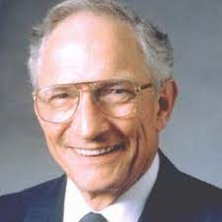

Motivation
Revolution of Microprocessor and Semiconductor (Transistor)
Robert Noyce (1927-1990)
“Mayor of Silicon Valley”
Confounder of Semiconductor
Confounder of INTEL
Co-inventor of IC
Gordon Moore
Confounder of INTEL
Moore’s Law: the number of transistors on a computer
chip doubles every year (observed in 1965)
Since 1975, transistor counts have doubled every two years.
Notes:
Semiconductor: a material having conductivity falling between conductor and insulator. Basis of any IC

Slide 5
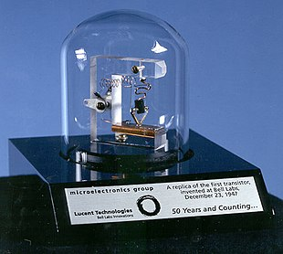
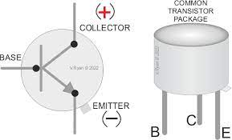
Semiconductor and Transistor
A transistor is a semiconductor device used to amplify or switch electrical signals and power.
One of the basic building blocks of modern electronics
Notes:
Semiconductor: a material having conductivity falling between conductor and insulator. Basis of any IC

Slide 6
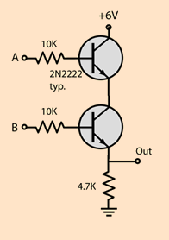
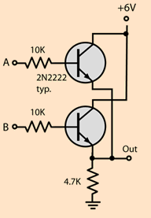
RTL diagram – AND and OR gate
Notes:
Semiconductor: a material having conductivity falling between conductor and insulator. Basis of any IC

Slide 7
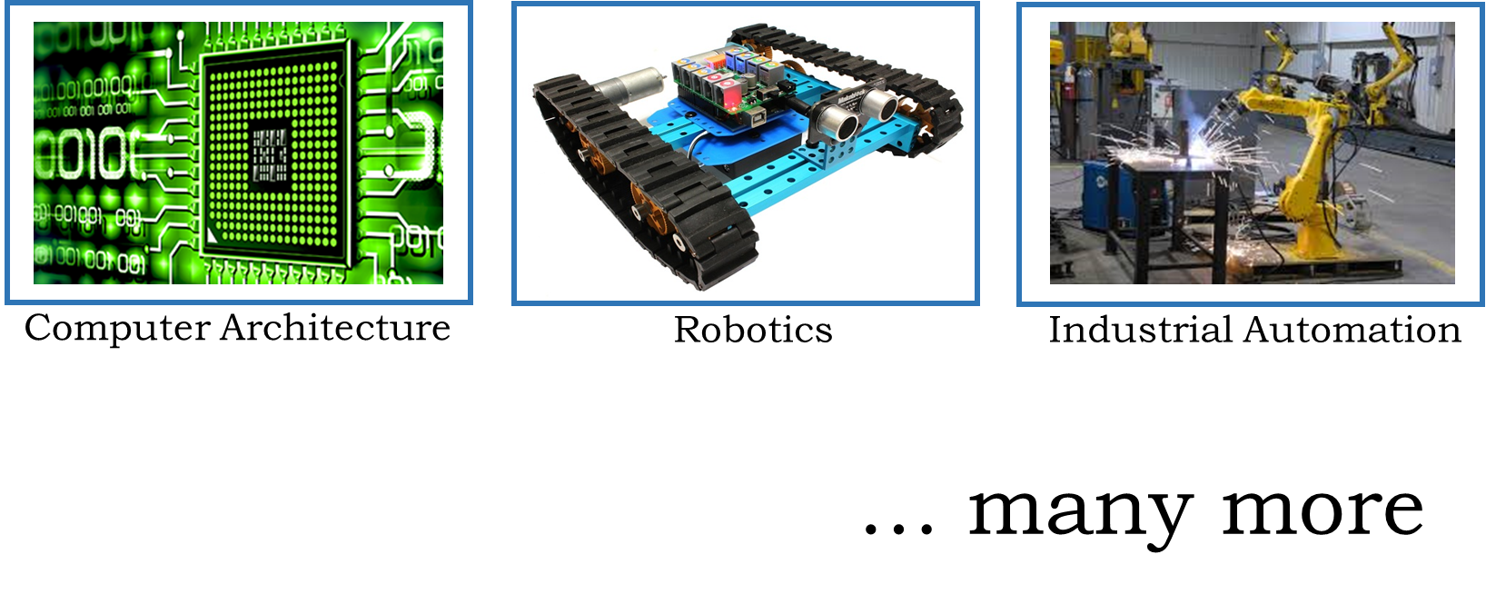

Prospect of this Course
Intelligent Security Control

Slide 8
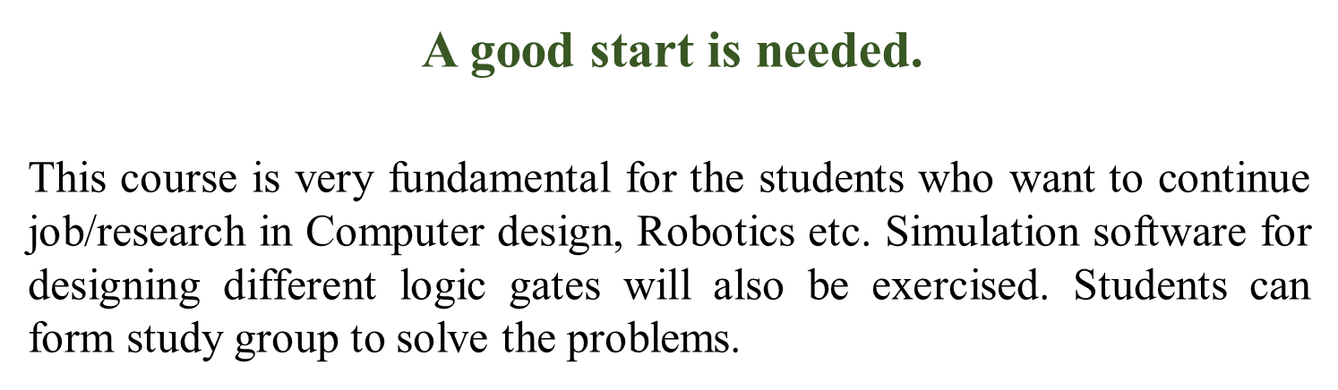
Prospect of this Course

Slide 9
Case Study - 1
L1
L 4
L 6
L2
L 5
L 7
L3

Slide 10
Case Study - 2
Add two 1-bit binary numbers
Input: 1 bit augend and 1 bit addend
Output: 1 bit carry and 1 bit sum

Slide 11
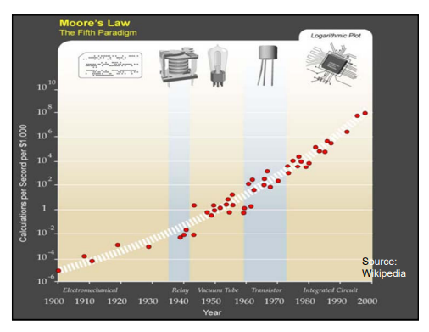
Evolution of Computer
Notes:
Semiconductor: a material having conductivity falling between conductor and insulator. Basis of any IC

Slide 12
Basic Idea
Logic gate [basic relationship] to build complex relationship
AND, OR, NOT
Definition
Symbol
Signals in waveform as INPUT
Truth Table to formulate the relationship
Logic expression: another way to re-express
Algebra and circuit
Prepackaged Building block – IC
Implementation of logic gates – Transistors
Signals
Analog – turning on (switch on) lights
Digital – Calculator
In real-life a threshold value is considered to convert an analog system to a digital one
Notes:
Semiconductor: a material having conductivity falling between conductor and insulator. Basis of any IC

Slide 13
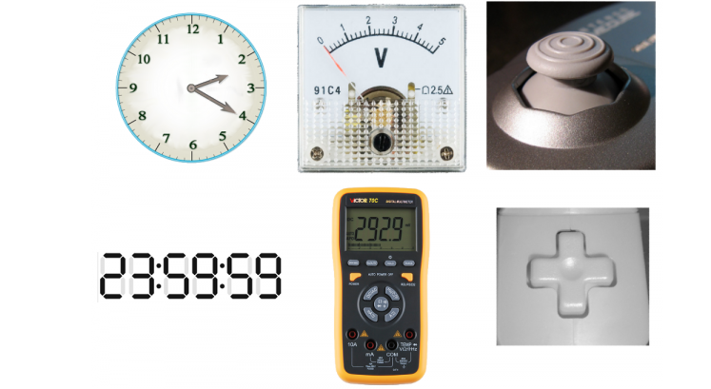
Circuit
Relationship among signals
Where the signals are provided in waveforms in time
Types:
Analog
Continuous values
Low accuracy and susceptible to noise
Digital
Discrete values
High accuracy and less susceptible to noise
Notes:
Semiconductor: a material having conductivity falling between conductor and insulator. Basis of any IC

Slide 14
ABC
ABC
Notes:
Semiconductor: a material having conductivity falling between conductor and insulator. Basis of any IC

Slide 15
ABC
ABC
Notes:
Semiconductor: a material having conductivity falling between conductor and insulator. Basis of any IC

Slide 16
ABC
ABC
Notes:
Semiconductor: a material having conductivity falling between conductor and insulator. Basis of any IC

Slide 17
ABC
ABC
Notes:
Semiconductor: a material having conductivity falling between conductor and insulator. Basis of any IC

Slide 18
ABC
ABC
Notes:
Semiconductor: a material having conductivity falling between conductor and insulator. Basis of any IC

